Slide 1



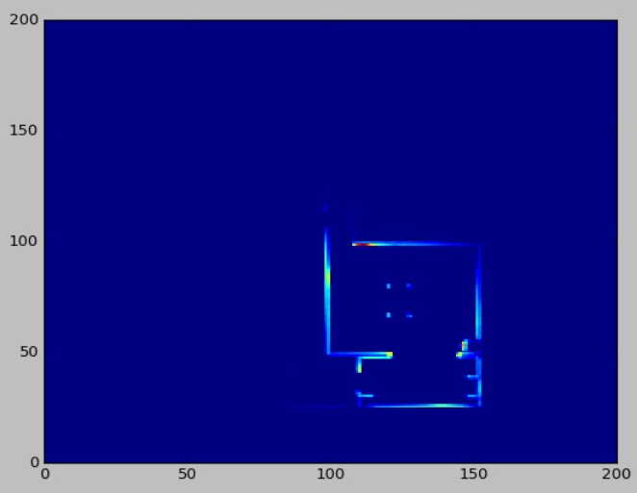
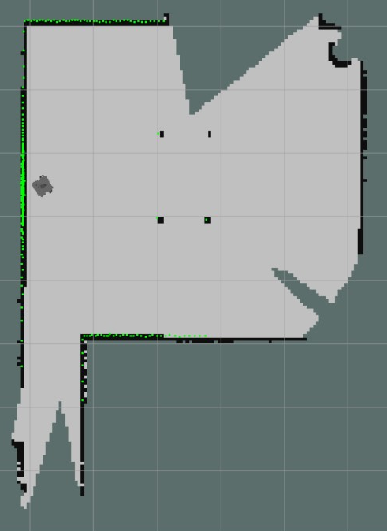
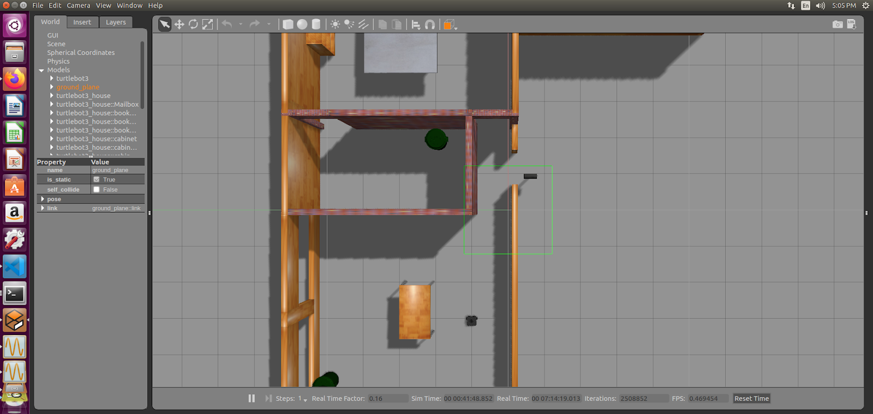
Autonomous Robot Exploration
Jessica De Mota Munoz, Zarin Ali, and Duvall Pinkey and Dr.Damian Lyons
Introduction
We conducted research to figure out what is the best way to autonomously map out a room. Autonomous vehicles and robots are increasingly visible in magazines and news stories. Mapping and exploration is important to issues such as search and rescue, surveillance, and home maintenance. It seems inevitable that autonomous robot systems will soon be a major commercial technology. Most maps are constructed manually using teleoperation. But when scaled to a larger space, self-directed mapping becomes even more important.
Our hypothesis, is that there is a higher chance of mapping out a room by tracing the walls in the room.
Results – Wall Tracer Algorithm
Conclusion
Overall, every algorithm that was made allowed the robot to explore new areas and speed up locations.
However, for further research we hope to build on increasing the efficiency on detecting walls and space better. We aim to improve the feedback we received from lasers that have detected a wall.
These Are The Maps Generated By Wall Tracer
This algorithm uses a 2D NumPy array data structure that represents the room. The wall histogram keeps track of what walls were detected by the robot. It also encourages the robot to go through doorways eventually.
Materials
Methodology
This Is Another Map Generated By Wall Tracer
This algorithm is an improvement to Wander such as that it opens possibilities for the robot to explore other rooms and at least map its walls more effectively.
ROS (Robot Operating System)
ROS Gmapping Stack
Gazebo simulator
RViz
Turtlebot3 Robot
Data Structure Components:
2D Numpy Array: Pose Histogram
2D Numpy Array: Wall Histogram
Algorithm #1 – Wander
The first approach to robot exploration was allowing the robot to wander the rooms at random speeds while avoiding obstacles. The wander algorithm, using the robot’s laser range finder, detects obstacles and turns away from them at a constant velocity. If no obstacle is detected, then the robot assumes a random velocity from 0.1 - 0.9 and random. Each algorithm was ran at the same location for a 5 -minute interval.
Acknowledgments
We’d like to thank Google Research for allowing us to come together and gain experience of research in the technical field.
We also want to thank, Dr. Damian Lyons for giving us the proper tools and resources to make this project possible.
As well as CUNY and Fordham University for partnering up with Google Research to give us this opportunity.
This is the environment in which we worked with our robot to explore beyond the doors and walls of the room.
Algorithm 2 (Speed Up)- consists of an algorithm that uses a 2D NumPy array data structure that represents the room. The pose histogram keeps track of where the robot has been.

